Slide 1
CHANGING YOUR AMERICA TO GO ORDER

Slide 2
After placing your America to go order you will receive a confirmation email containing the following information:
America To Go order number
Restaurant
Expected Deliver
Items ordered
Keep this email for reference in case future order changes are necessary

Slide 3
If changes to an order are needed they can be made in the America To Go website.
To access the site go to the Hokiemart Homepage and punchout to the America To Go site.
From the ATG Landing page Click on the My Orders Tab

Slide 4
Locate the Order ID number from the listing that matches the ID number on your America To Go email confirmation
On the right hand side of the listing choose the Select Action drop down box
The options that will be available on this drop down will depend on what stage your order is at with America to Go and the Caterer

Slide 5
If the edit option is available the order can have changes made to it
Click on the edit option

Slide 6
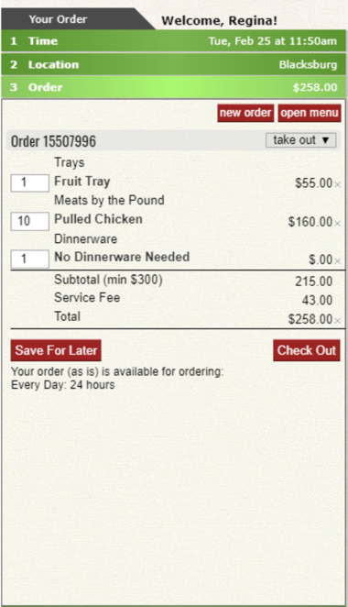
The order will open in the America to Go wizard along with the catering menu
From the wizard you will have the options to make the following changes
Remove and entire line item by clicking the x next to the item price
Change the quantity ordered by entering a new number in the quantity box
Adjust the gratuity if it is an option for the caterer

Slide 7
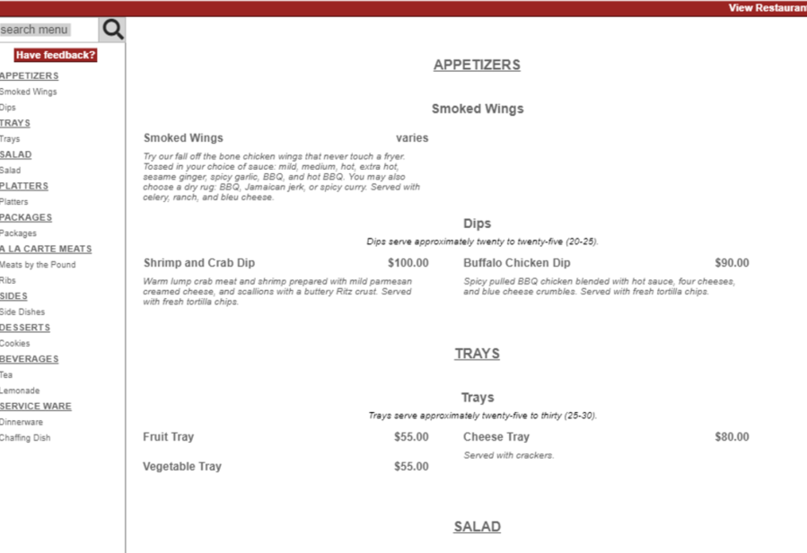
From the Menu you can pick additional items to add to the wizard
This menu and functions work exactly like when placing the original order
This menu will function exactly as it did when placing the original order

Slide 8
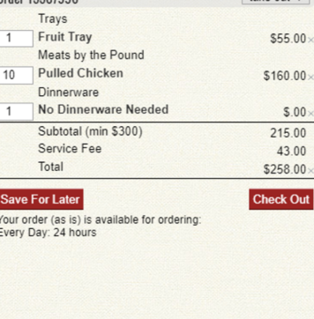
When all changes to the order are completed click the Check Out button to start the order completion process
When all the steps are complete you will receive a new confirmation email from America To Go with your changes

Slide 9
CANCELING YOUR AMERICA TO GO ORDER

Slide 10
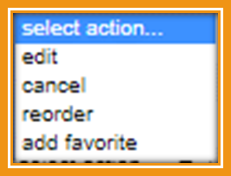
Access the America to Go order following the same previously documented steps as when making a change to your order
If the drop down option Cancel Order is available you can choose that option to cancel your America To Go Order

Slide 11
NOTICE: When you choose this Cancel function the order is automatically cancelled without an option to go back or undo
Click ok
You will receive a confirmation email from America To Go confirming the cancellation of your order

Slide 12
If you feel unsure about making these changes or cancellations on your own you always have to option to contact America To Go customer service at (212) 790-9587 and they can make these changes for you.
**********
Remember that if you make changes to your order note these changes in your Hokiemart Receipt and let AP know it is ok to pay the adjusted amounts.
(These directions can be found in the Receiving and Invoicing instructions)
**********
Remember that if you cancel your order with America To Go you will still need to complete a Receipt in Hokiemart choosing the Cancel option.
(***Note: As with any Hokiemart order doing the Cancellation receipt in hokiemart does not cancel the order with America to Go, cancellations must be done in both places)

