Slide 1

America to go order
In Hokiemart

Slide 2
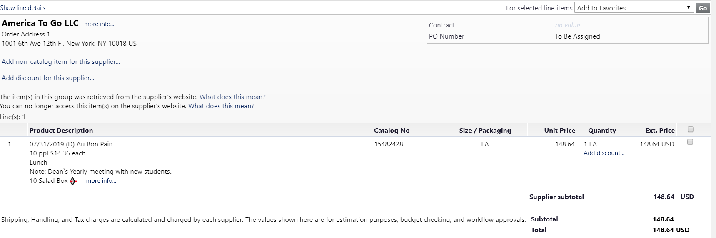
After punching out from your America To Go site back to the hokiemart cart proceed with your order.
Remember your order will be to America To Go LLC not to the Caterer or Restaurant that your food is coming from.
Your description will contain the following:
The caterer or restaurant that is providing the food and event date.
The meal either Breakfast, Lunch or Dinner.
The business purpose which should be the name of the event in order to make tracking easier.
The number of attendees and the calculated per person pricing
The description along of the items ordered.
(Remember Hokiemart allows for a set amount of characters, so if all items do not show in description you can always look at your ATG order confirmation to see exactly what is ordered.)

Slide 3

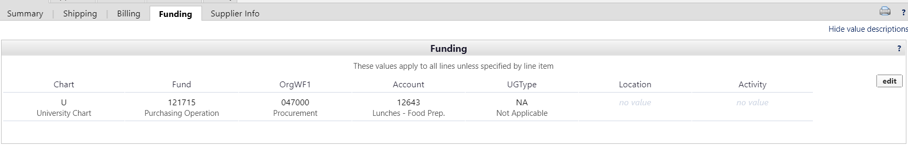
Hokiemart Funding
In the Hokiemart cart proceed to check out
Input proper funding and account code information following normal hokiemart procedures. You may split the funding if necessary as you would on any other hokiemart order.
***(Note: if you are funding your entire event with Foundation Funds you do not use America to Go in Hokiemart but instead follow VT Foundation ordering rules and policies)

Slide 4
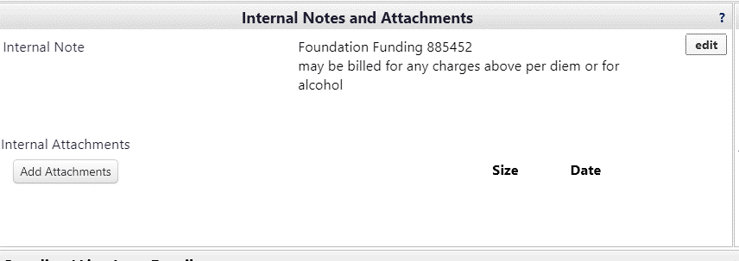
Internal Notes & Attachments In the Hokiemart CART
Internal notes and attachments are for any information that you would like to make a permanent part of the requisition. You can also include anything that the controllers office can use when evaluating your America To Go order.
In the internal notes you may put a foundation fund that any charges over the per diem or for alcohol may be billed to by the controllers office.

Slide 5
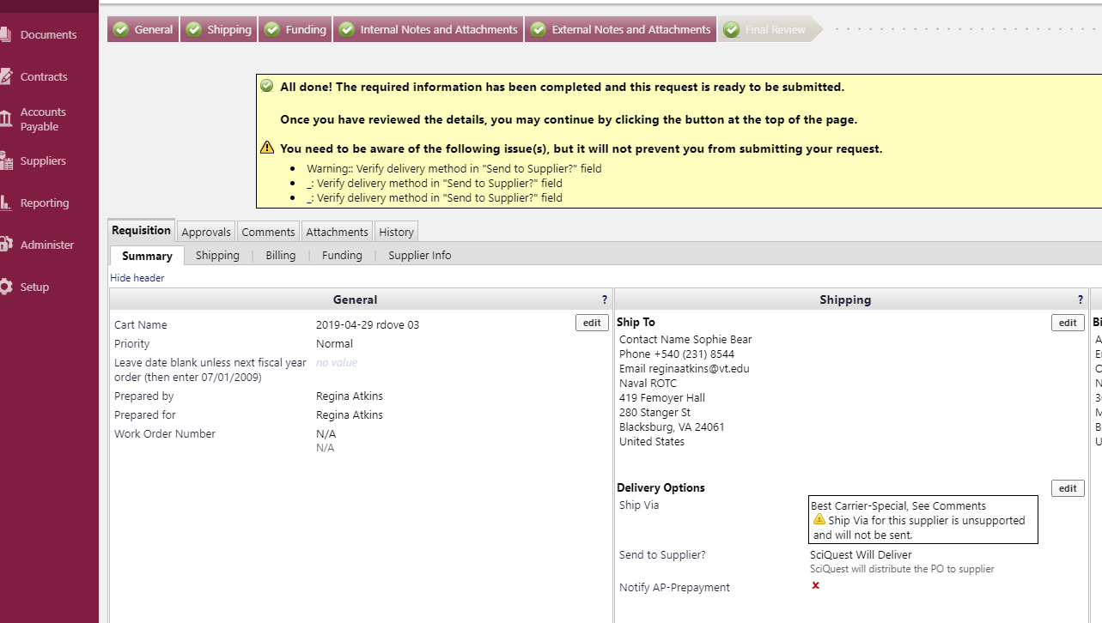
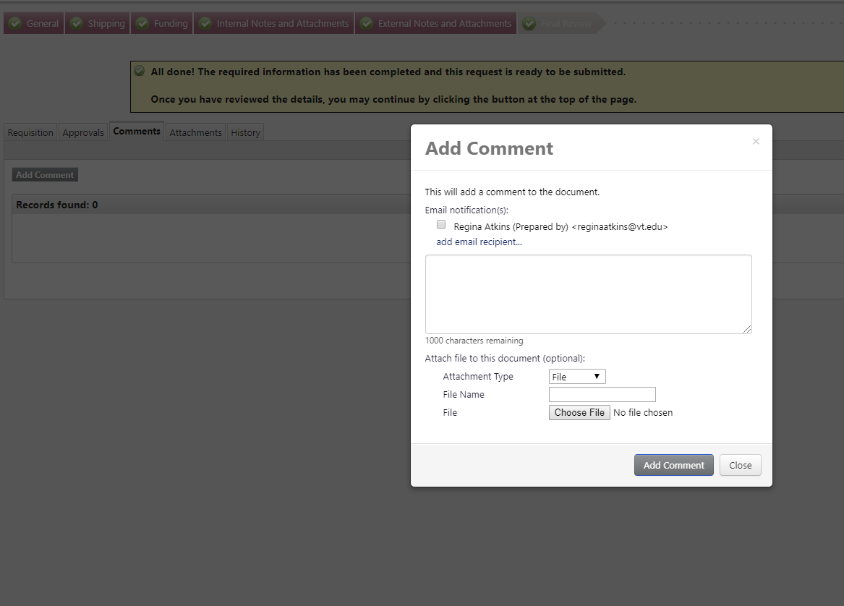
Obtaining Pre-Approval for the event from Accounts Payable
Approval for the event to be paid for on State Funds can be obtained by putting a comment in the Hokiemart PR prior to completing the order
Do this by clicking on the Comments tab in the cart
Click on Add Comment
Click on Add an email recipient

Slide 6
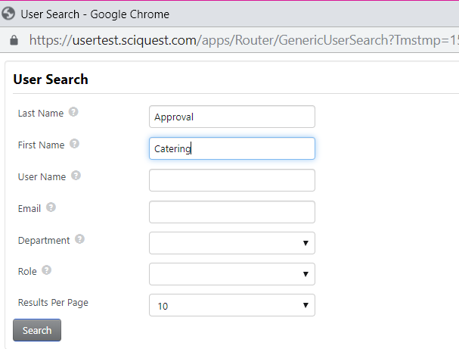
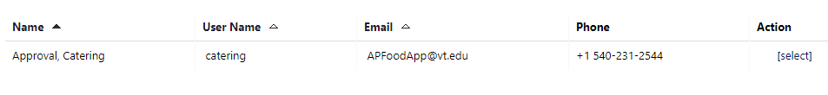
When the search box opens enter the following:
Last Name: Approval
First Name: Catering
Click Search
A user will display
Choose [select] under Action.

Slide 7
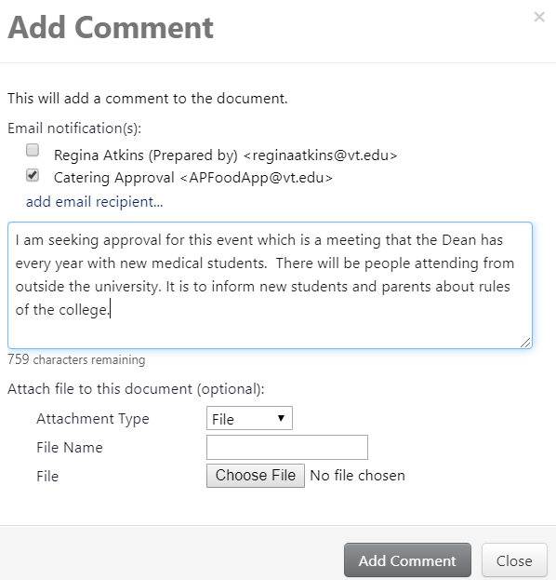
In the comment include what group will be attending the event, (individual names are not required at this time.)
Include any information about the event that the controllers office may need to see in order to give the ok to proceed with the event.
AP should reply via a Hokiemart comment within 48 Business hours. If the event is not approved for payment on state funds the user will cancel the order with ATG and in Hokiemart. If the user still wants to have the event use foundation funds, rules and procedures to purchase outside of the hokiemart system.
In a case when the event happens prior to receiving AP approval the department will proceed at their own risk assuming it will be approved for purchase on state funds.

Slide 8
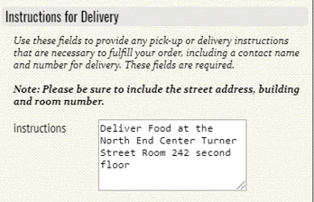
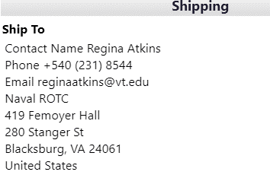
Delivery Address of your America To Go Catering Order
America To Go Site
Hokiemart Cart Default
***The caterer will receive their delivery address and instructions from the America To Go site under Instructions for Delivery. ***
The default ship to address in the Hokiemart cart will not be seen by the caterer.

Slide 9
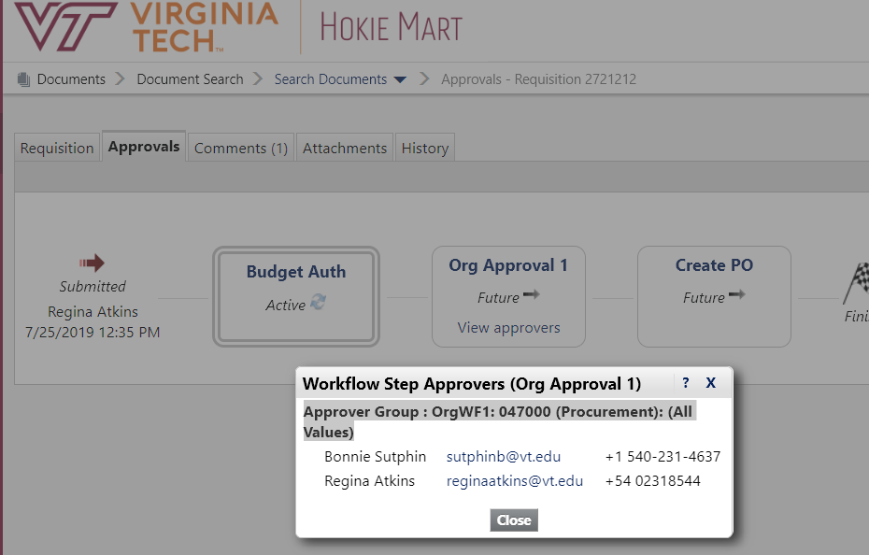

Hokiemart APprovals
After submitting the PR it will follow the Hokiemart workflow for approvals and then create a purchase order.
The purchase order will be sent electronically to America To Go
America To Go will send your order through their system to the caterer.
Note: The caterer will get the order from America To Go and follow their procedures to verify receipt.

Slide 10
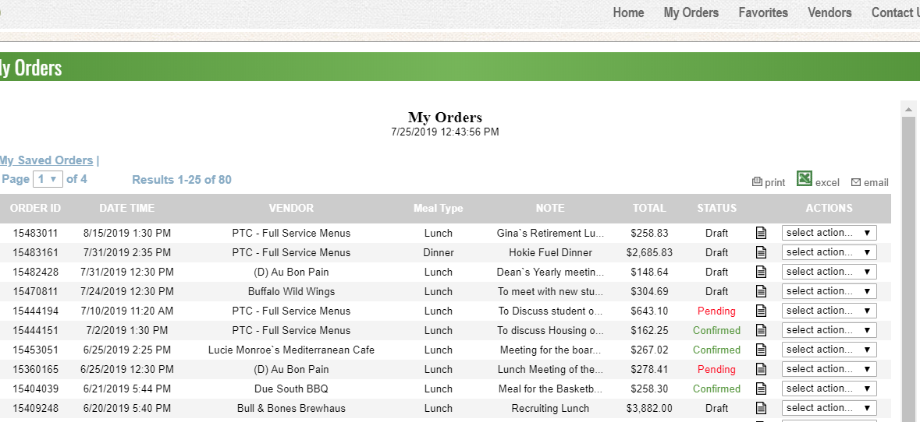
Order Status in America To go
Status of the order can be monitored by going to the ATG punchout and selecting MY ORDERS.
Your order will show Draft if not submitted, Pending if waiting for Caterer verification, or confirmed if it has been confirmed by the caterer.
You can communicate with the caterer about your order in person, by phone, or through America To Go customer service.

